Slide 1
Chapter 2: System Structures - 3

Slide 2
Chapter 2: Operating-System Structures
Operating System Services
User Operating System Interface
System Calls
Types of System Calls
System Programs
Operating System Design and Implementation
Operating System Structure
Virtual Machines
Operating System Debugging
Operating System Generation
System Boot

Slide 3
Objectives
To describe the services an operating system provides to users, processes, and other systems
To discuss the various ways of structuring an operating system
To explain how operating systems are installed and customized and how they boot

Slide 4
Operating System Services
One set of operating-system services provides functions that are helpful to the user:
  User interface - Almost all operating systems have a user interface (UI)
    Varies between Command-Line (CLI), Graphics User Interface (GUI), Batch
  Program execution - The system must be able to load a program into memory and to run that program, end execution, either normally or abnormally (indicating error)
  I/O operations - A running program may require I/O, which may involve a file or an I/O device
  File-system manipulation - The file system is of particular interest. Obviously, programs need to read and write files and directories, create and delete them, search them, list file Information, permission management.

Slide 5
Operating System Services (Cont)
One set of operating-system services provides functions that are helpful to the user (Cont):
  Communications – Processes may exchange information, on the same computer or between computers over a network
    Communications may be via shared memory or through message passing (packets moved by the OS)
  Error detection – OS needs to be constantly aware of possible errors
    May occur in the CPU and memory hardware, in I/O devices, in user program
    For each type of error, OS should take the appropriate action to ensure correct and consistent computing
    Debugging facilities can greatly enhance the user’s and programmer’s abilities to efficiently use the system

Slide 6
Operating System Services (Cont)
Another set of OS functions exists for ensuring the efficient operation of the system itself via resource sharing
  Resource allocation - When multiple users or multiple jobs running concurrently, resources must be allocated to each of them
    Many types of resources - Some (such as CPU cycles, main memory, and file storage) may have special allocation code, others (such as I/O devices) may have general request and release code
  Accounting - To keep track of which users use how much and what kinds of computer resources
  Protection and security - The owners of information stored in a multiuser or networked computer system may want to control use of that information, concurrent processes should not interfere with each other
    Protection involves ensuring that all access to system resources is controlled
    Security of the system from outsiders requires user authentication, extends to defending external I/O devices from invalid access attempts
    If a system is to be protected and secure, precautions must be instituted throughout it.

Slide 7

A View of Operating System Services

Slide 8
User Operating System Interface - CLI
Command Line Interface (CLI) or command interpreter allows direct command entry
    Sometimes implemented in kernel, sometimes by systems program
    Sometimes multiple flavors implemented – shells
    Primarily fetches a command from user and executes it
      Sometimes commands built-in, sometimes just names of programs
        If the latter, adding new features doesn’t require shell modification

Slide 9
User Operating System Interface - GUI
User-friendly desktop metaphor interface
  Usually mouse, keyboard, and monitor
  Icons represent files, programs, actions, etc
  Various mouse buttons over objects in the interface cause various actions (provide information, options, execute function, open directory (known as a folder)
  Invented at Xerox PARC
Many systems now include both CLI and GUI interfaces
  Microsoft Windows is GUI with CLI “command” shell
  Apple Mac OS X as “Aqua” GUI interface with UNIX kernel underneath and shells available
  Solaris is CLI with optional GUI interfaces (Java Desktop, KDE)

Slide 10
System Calls
Programming interface to the services provided by the OS
Typically written in a high-level language (C or C++)
Mostly accessed by programs via a high-level Application Program Interface (API) rather than direct system call use
Three most common APIs are Win32 API for Windows, POSIX API for POSIX-based systems (including virtually all versions of UNIX, Linux, and Mac OS X), and Java API for the Java virtual machine (JVM)
Why use APIs rather than system calls?

Slide 11

Example of System Calls
System call sequence to copy the contents of one file to another file

Slide 12
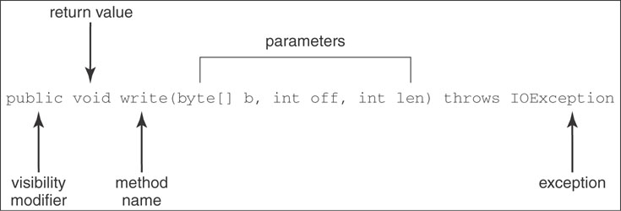
Example of Standard API
Consider the write() method in java.io.OutputStream class
Java API— a function that allows writing to a file or a network connection
A description of the parameters passed to write()
  byte[ ] b — the data to be written
  int off – the starting offset in the array b to be written
  int len — the number of bytes to be written

Slide 13
System Call Implementation
Typically, a number associated with each system call
  System-call interface maintains a table indexed according to these numbers
The system call interface invokes intended system call in OS kernel and returns status of the system call and any return values
The caller need know nothing about how the system call is implemented
  Just needs to obey API and understand what OS will do as a result call
  Most details of OS interface hidden from programmer by API

Slide 14

API – System Call – OS Relationship

Slide 15

Standard C Library Example
C program invoking printf() library call, which calls write() system call

Slide 16
System Call Parameter Passing
Often, more information is required than simply identity of desired system call
  Exact type and amount of information vary according to OS and call
Three general methods used to pass parameters to the OS
  Simplest: pass the parameters in registers
    In some cases, may be more parameters than registers
  Parameters stored in a block, or table, in memory, and address of block passed as a parameter in a register
    This approach taken by Linux and Solaris
  Parameters placed, or pushed, onto the stack by the program and popped off the stack by the operating system
Block and stack methods do not limit the number or length of parameters being passed

Slide 17

Parameter Passing via Table

Slide 18
Types of System Calls
Process control
File management
Device management
Information maintenance
Communications
Protection

Slide 19

Examples of Windows and Unix System Calls

Slide 20
System Programs (or System Utilities)
System programs provide a convenient environment for program development and execution. The can be divided into:
  File manipulation
  Status information
  File modification
  Programming language support
  Program loading and execution
  Communications
  Application programs
Most users’ view of the operating system is defined by system programs, not the actual system calls

Slide 21
System Programs
Provide a convenient environment for program development and execution
  Some of them are simply user interfaces to system calls; others are considerably more complex
File management - Create, delete, copy, rename, print, dump, list, and generally manipulate files and directories
Status information
  Some ask the system for info - date, time, amount of available memory, disk space, number of users
  Others provide detailed performance, logging, and debugging information
  Typically, these programs format and print the output to the terminal or other output devices
  Some systems implement a registry - used to store and retrieve configuration information

Slide 22
System Programs (cont’d)
File modification
  Text editors to create and modify files
  Special commands to search contents of files or perform transformations of the text
Programming-language support - Compilers, assemblers, debuggers and interpreters sometimes provided
Program loading and execution- Absolute loaders, relocatable loaders, linkage editors, and overlay-loaders, debugging systems for higher-level and machine language
Communications - Provide the mechanism for creating virtual connections among processes, users, and computer systems
  Allow users to send messages to one another’s screens, browse web pages, send electronic-mail messages, log in remotely, transfer files from one machine to another

Slide 23
Operating System Design and Implementation
Design and Implementation of OS not “solvable”, but some approaches have proven successful
Internal structure of different Operating Systems can vary widely
Start by defining goals and specifications
Affected by choice of hardware, type of system
User goals and System goals
  User goals – operating system should be convenient to use, easy to learn, reliable, safe, and fast
  System goals – operating system should be easy to design, implement, and maintain, as well as flexible, reliable, error-free, and efficient

Slide 24
Operating System Design and Implementation (Cont)
Important principle to separate
Policy: What will be done?
Mechanism: How to do it?
Mechanisms determine how to do something, policies decide what will be done
  The separation of policy from mechanism is a very important principle, it allows maximum flexibility if policy decisions are to be changed later.
  e.g. in CPU protection context, the value of timer counter for any process is not decided by default by OS but it can be given to the system administrator to decide about the timer value for the process as a policy maker.

Slide 25
Simple Structure
MS-DOS – written to provide the most functionality in the least space
  Not divided into modules
  Although MS-DOS has some structure, its interfaces and levels of functionality are not well separated

Slide 26

MS-DOS Layer Structure

Slide 27
UNIX
UNIX – limited by hardware functionality, the original UNIX operating system had limited structuring. The UNIX OS consists of two separable parts
  Systems programs
  The kernel
    Consists of everything below the system-call interface and above the physical hardware
    Provides the file system, CPU scheduling, memory management, and other operating-system functions; a large number of functions for one level

Slide 28

Traditional UNIX System Structure

Slide 29
Layered Approach
The operating system is divided into a number of layers (levels), each built on top of lower layers. The bottom layer (layer 0), is the hardware; the highest (layer N) is the user interface.
With modularity, layers are selected such that each uses functions (operations) and services of only lower-level layers

Slide 30

Layered Operating System

Slide 31
Microkernel System Structure
Moves as much from the kernel into “user” space
Communication takes place between user modules using message passing
Benefits:
  Easier to extend a microkernel
  Easier to port the operating system to new architectures
  More reliable (less code is running in kernel mode)
  More secure
Detriments (Disadvantage):
  Performance overhead of user space to kernel space communication

Slide 32
Modules
Most modern operating systems implement kernel modules
  Uses object-oriented approach
  Each core component is separate
  Each talks to the others over known interfaces
  Each is loadable as needed within the kernel
Overall, similar to layers but with more flexible

Slide 33

Solaris Modular Approach

Slide 34
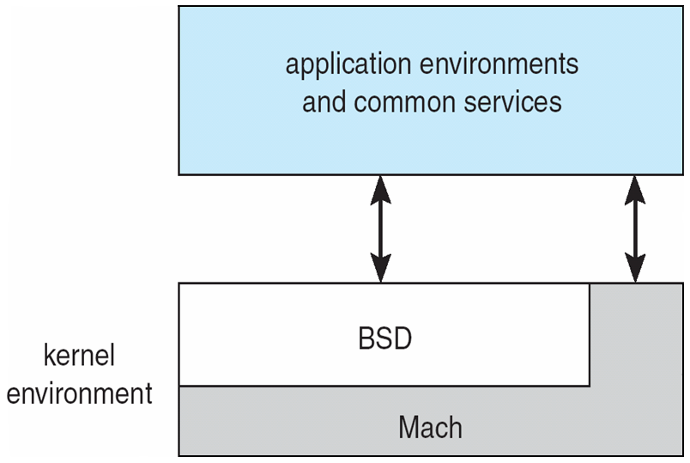
Mac OS X Structure
Apple Mac OS has Hybrid Structure:
Mach Microkernel & BSD Kernel
Mach Microkernel provides Memory management, Support of RPC, and IPC including message passing and thread scheduling.
BSD provides the BSD CLI, support for networking and file systems, implementation of POSIX APIs.
Support the idea of dynamically loadable modules.

Slide 35
Virtual Machines
A virtual machine takes the layered approach to its logical conclusion. It treats hardware and the operating system kernel as though they were all hardware
A virtual machine provides an interface identical to the underlying bare hardware
The operating system host creates the illusion that a process has its own processor and (virtual memory)
Each guest provided with a (virtual) copy of underlying computer

Slide 36
Virtual Machines History and Benefits
First appeared commercially in IBM mainframes in 1972
Fundamentally, multiple execution environments (different operating systems) can share the same hardware
Protect from each other
Some sharing of file can be permitted, controlled
Communicate with each other, other physical systems via networking
Useful for development, testing
Consolidation of many low-resource use systems onto fewer busier systems
“Open Virtual Machine Format”, standard format of virtual machines, allows a VM to run within many different virtual machine (host) platforms

Slide 37

Virtual Machines (Cont)
(a) Nonvirtual machine (b) virtual machine
Non-virtual Machine
Virtual Machine

Slide 38
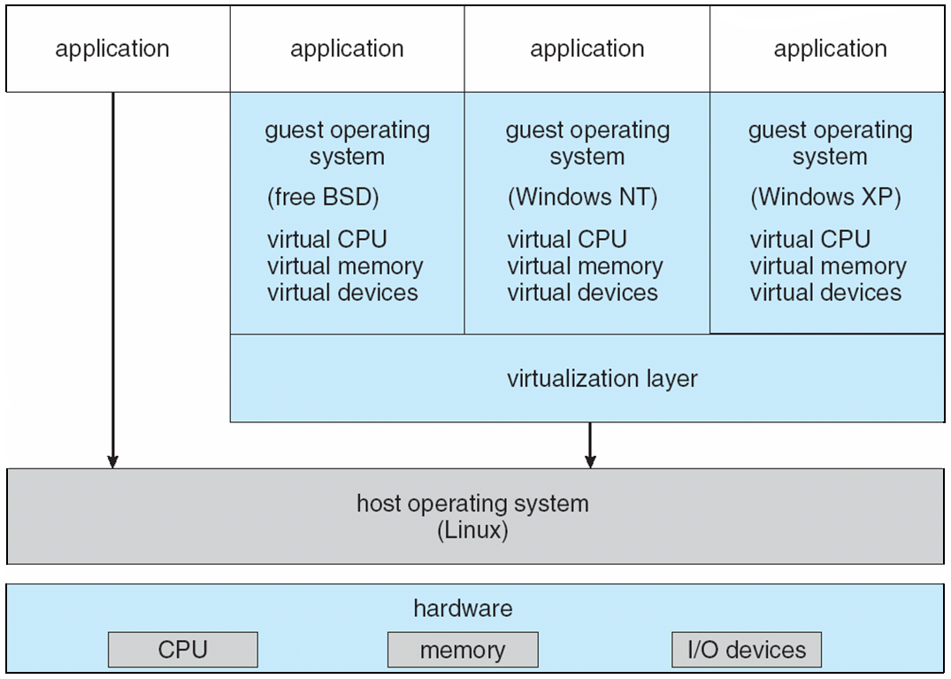
VMware Architecture

Slide 39
Java
Java consists of
  Programming language specification
  Application programming interface (API)
  Virtual machine specification

Slide 40

The Java Virtual Machine

Slide 41
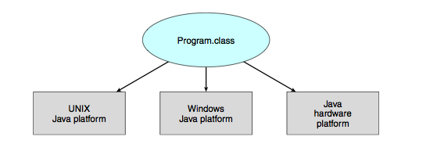
The Java Virtual Machine
Java portability across platforms.

Slide 42
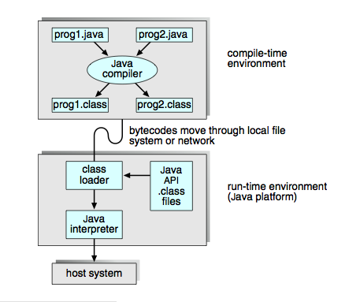
The Java Development Kit

Slide 43
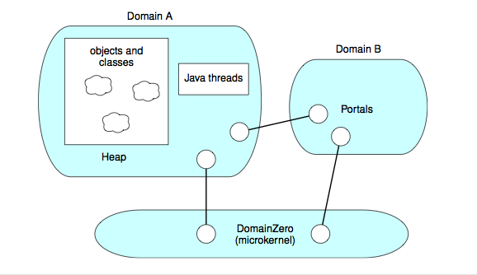
Java Operating Systems
The JX operating system
Each domain represent an independent JVM
Domain 0 is microkernel; responsible for low level details such as system initialization and saving & restoring the state of the CPU. It is written in C and Assembly language.
All other domains are written in Java.
Communication between domains take place through Portals; similar to RPCs

Slide 44
Operating-System Debugging
Debugging is finding and fixing errors, or bugs
OSes generate log files containing error information
Failure of an application can generate core dump file capturing memory of the process
Operating system failure can generate crash dump file containing kernel memory
Beyond crashes, performance tuning can optimize system performance
Kernighan’s Law: “Debugging is twice as hard as writing the code in the ﬁrst place. Therefore, if you write the code as cleverly as possible, you are, by deﬁnition, not smart enough to debug it.”

Slide 45
System Boot
Operating system must be made available to hardware so hardware can start it
  Small piece of code – bootstrap loader, locates the kernel, loads it into memory, and starts it
  Sometimes two-step process where boot block at fixed location loads bootstrap loader
  When power initialized on system, execution starts at a fixed memory location
    Firmware used to hold initial boot code

Slide 46
End of Chapter 2

Slide 47
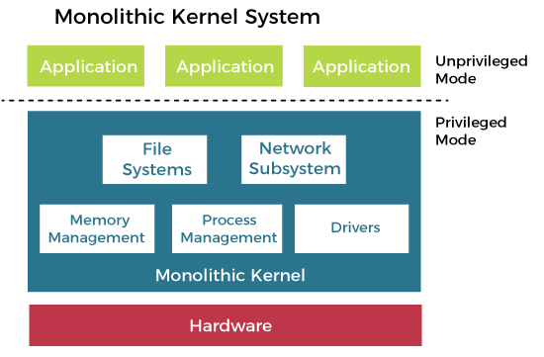
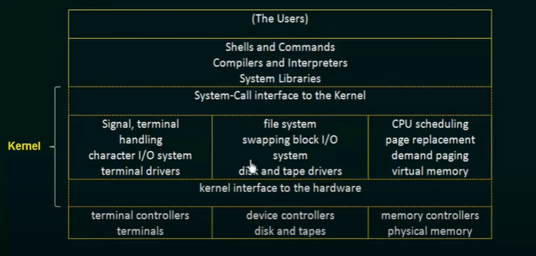
Operating System Structure
Example Unix, Linux, IOS is hybrid
Notes:
Operating system was like a black box. All activities of operating system were part of kernel and stored in kernel space, executed in kernel mode. It was highly efficient because there was a clear boundary between user and kernel space but it was very hard to maintain and extend. It was a good option when there was a limited RAM. Each component of operating system was contained in kernel. All activities of operating system were executed in kernel space.
Monolethic structure was followed by earlier Unix operating system.

Slide 48
Advantages
Here are some advantages of the monolithic kernel, such as:
The execution of the monolithic kernel is quite fast as the services such as memory management, file management, process scheduling, etc., are implemented under the same address space.
A process runs completely in single address space in the monolithic kernel.
The monolithic kernel is a static single binary file.
Here are some disadvantages of the monolithic kernel, such as:
If any service fails in the monolithic kernel, it leads to the failure of the entire system.
The entire operating system needs to be modified by the user to add any new service.

Slide 49
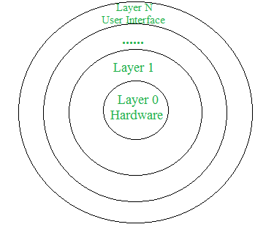
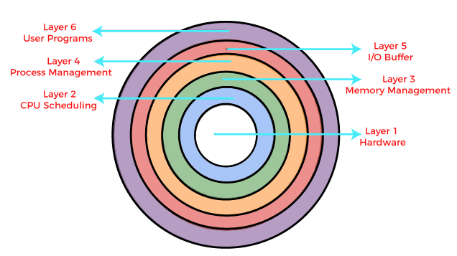
Layered Architecture of Operating System
Example Windows NT
Notes:
In this moduler architecture the lowest or inner most layer also called Layer 0 or ring zero is the highest privileged mode, all hardware related and core funactions or operating system are executed in this mode. And the outermost layer, hey layer N is the lowest privileged mode. When an application program try to exdcute any instruction that is to be executed in high privileged mode, the CPU stop that application and tells the high privileged mode that an application is trying something in appropriate then low privileged mode decide what to do next. Instruction set of operating system is actually divided into layers. This layerd architecture is not practically used yet, only two layerd acritecture, high privileged and low privileged is used yet. This approach is the future.
If you are working in low privileged mode and wants to hand over control to low privileged mode, the mode bit or mode flag will be set and then control will be transferred to application layer, if application layer try to violate and try to execute an instruction that is to be executed in high privileged, cpu will halt the application and will inform high privileged mode.
Whenever a low privileged application tries to execute a high privileged instruction , a trap occurs, execution of program is stopped, control is passed to operating system, flag is set to high privileged mode and then operating system decides course of action, OS decided what to do when an application is trying to execute high privileged instruction.
Trap is an interrupt triggered by an exeception in the user process, when a user process try to access some invalid instructions or raises an excetion, trap is generated. Trap changes the mode to kernel mode, then operating system takes some action, and control is returned back to the running application. These some instructions executed in kernel mode are actually trap handling routine that OS executes. Interrupt is either hardware or software signal that demands immediate attention from operating system.
Additionally, a specific bus control line called the Interrupt Service Routine (ISR) handles interrupts in I/O devices.

Slide 50
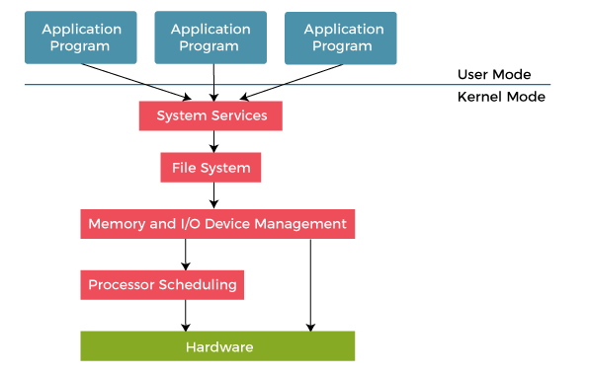
Functionalities or services of kernel are divided or categorized into layers.
Each layer is responsible for carrying out a specific service.
A layer can only use services of a layer which is below it
Notes:
For example the virtual memory management layer will be under the memory management layer. As virtual memory need services of memory management
Clearly defining boundaries between layers and deciding which servies belongs to specific layer and deciding which layer comes under another layer is really a problem.
Advanatge of this structure is hardware is protected from the users. But this layered approach is not efficient as once a user request a service from I/O device, this request will pass through all the layers until it reaches the hardware layer. I/O request will generate system call, system call will pass though all layers, at each layer, it will be processed and certain parameters added and hence it will take lots of time.

Slide 51
Advantages and Disadvantages
Debugging and modification is easier
Changes in one module does not affect other module
User has no direct access to hardware
Most of the programs are executed in user mode.
Disadvantages
Deciding which module is part of which layer is critical
It is slower in execution as system call from one layer has to pass through all layers below it.
Modules or functionalities cannot always be divided into layers.

Slide 52
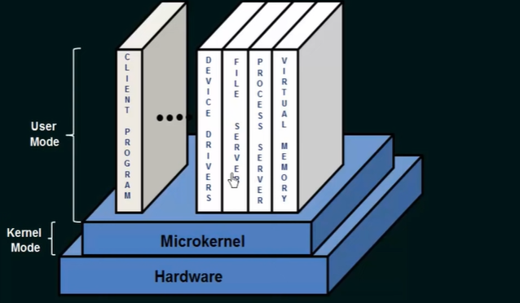
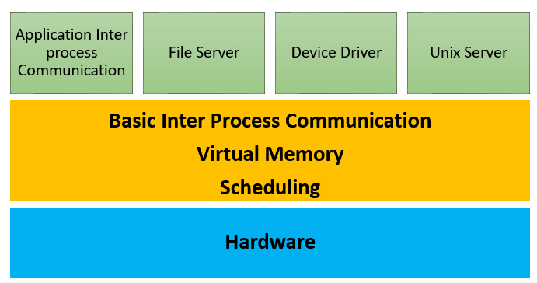
MicroKernel
Notes:
In micro kernel, we remove some modules and services from kernel space and implement them as user or system program thus reducing the size of kernel. Only the core functionalities are implemented in kernel space and everything else like device drivers, file servers, virtual memory are implemented as system programs in usr address space.
Windows NT used layered approach as part of it
on;ly core functions of OS are included in kernel and rest are implemented as user or service programs and kernel provides communication between user programs and service programs.
Communication between client program and system program is implemented via message passing
F a user program crashes, it will have no impact on kernel
It has lots of system overhead leading towards performance degradation
Micro kernel architectures are only used in research and highly security envoirnemnt. There sis no general purpose operating system that is based on micro kernel architecture. Micro kernel architectures are very difficult to implement as for every single module, designer need to define previliges Which module is allowed to run in which privilege mode.
With a microkernel architecture, there is a core and plugins. The core application is centralized, like a monolith. And most additional development is done through plugins that add capabilities or modify existing functionality. Generally, these plugins do not know about each other and do not communicate with each other. However, the microkernel provides interprocess communication -- a way for the processes to talk.
In microkernel architecture, kernel itself only contains core functionalities and additional features are added as a plugin into it. Like Grammerly plugin to chrome. What is plugin used for?
plug-in, also called add-on or extension, computer software that adds new functions to a host program without altering the host program itself. Widely used in digital audio, video, and Web browsing, plug-ins enable programmers to update a host program while keeping the user within the program's environment. WordPress plugins are small software apps that integrate and run on top of the WordPress software. This allows you to create almost any kind of website with WordPress, not just blogs. For example, you can: Start an online store with WordPress using the WooCommerce plugin.
The minimum functionalities required in the Microkernel are:
Memory management mechanisms like address spaces should be included in the Microkernel. It also contains memory protection features.
Processor scheduling mechanisms should contain process and thread schedulers.
Inter-process communication manages the servers that run their own address spaces.
Good places for a microkernel
Consider a microkernel architecture when you have a base application that uses bolted-on features and skins, or one that must be customized for clients. For example, a base accounting application could offer premium extensions. Many ERP applications already welcome extensions and operate in an entire third-party ecosystem.
If your application needs extensions, or you are trying to make a monolith's code independently testable, then consider the microkernel architecture.

Slide 53
Advantages Disadvantages
Advantages of Microkernel –
The architecture of this kernel is small and isolated hence it can function better.
Expansion of the system is easier, it is simply added to the system application without disturbing the kernel.
Here, are drawback/cons of using Microkernel:
Providing services in a microkernel system are expensive compared to the normal monolithic system.
Context switch or a function call needed when the drivers are implemented as procedures or processes, respectively.

Slide 54
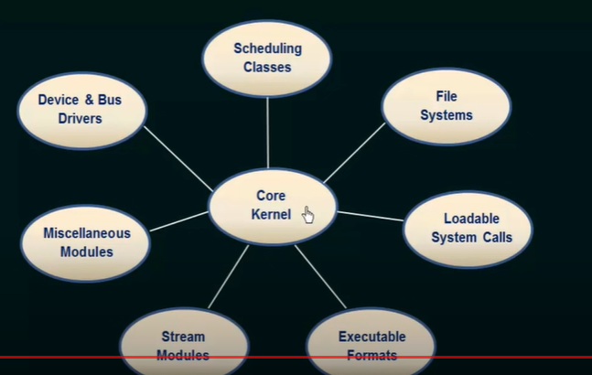
Modular Architecture
Notes:
We use modular or object oriented approach to design an operating system. Only core functions of operating system are present in the Kernel module, all the other functions or services are implemented as independent modules and these modules are loaded into kernel at run time or at boot time. Modules are loaded as and when required
Any module can call any other module which was not possible in layerd approach as module can only call module below it. Since these modules are directly loaded into kernel when needed, they do not need to any IPC or message passing as we did in microkernel

Slide 55
High Privileged Mode
Also known as supervisor or system mode.
Can access restricted areas of memory
Create, delete, halt a process
Context switching
Low Privileged Mode
Load and store instruction
Add and subtract instructions
Access to normal memory location is not high privileges
Status register indicates that in which mode the instruction is to be executed.
Notes:
If an instruction in low privileged mode tries to execute an instruction of high privileged mode, CPU halts automatically
So when you run an app as an administrator, it means you are giving the app special permissions to access restricted parts of your Windows 10 system that would otherwise be off-limits. This brings potential dangers, but it is also sometimes necessary for certain programs to work correct
Intel, at time of manufacturing their processors clearly defined which instruction is high privileged and which one is low privileged. Executing an interrupt is low privileged, any process can generate interrupt. Setting flags or regiters of CPU is high privileged as not everyone can sett the CPU registers.

Slide 56
System Call
Operating system has set of services
Every user program, for each single action, sends a call to specific service of operating system.
Each system call is assigned a specific number, an application sets system call number, before setting or issuing system call number it sets the required parameter in pre-defined locations where OS knows that parameters are here
For example in registers or in specific memory lcation.
When system call number is issued by application program, parameters of current process are saved, trap is issued to switch to kernel mode from user mode.
Notes:
POSIX is a standard by IEEE that decides that every operating system must have these specific set of services or funcionalakites.. Windows is not POSIX complained, MAC comply POSIX
OSDI conference of Operating system
We need to understand context switching for better performance, how can I implement a process with two system calls instead of one in order to make it more efficient therefore we need to study it
We study assembly language for high performance
Instead of INT (Interrupt) now we use SysEnter which is interrupt implemented at hardware level SysEnter is much faster than INT

Slide 57
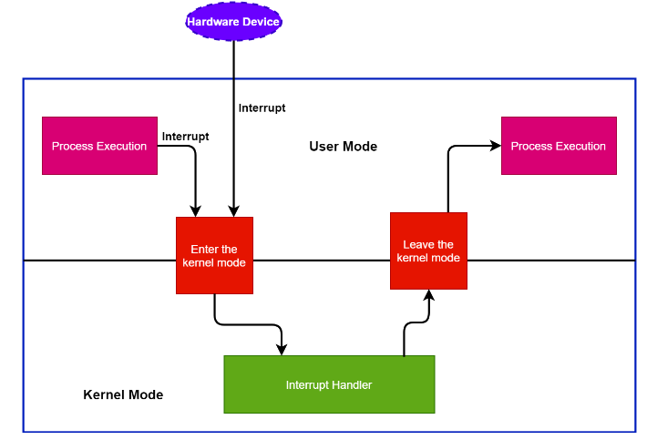

Slide 58

Interrupt handling
Notes:
We cannot allow only one process to run on CPU all the time, since user work with lots of applications, we need to give CPU to multiple proceses. In older versions of operating system, proceses yields their control and give them to operating system to allow operating system to execute other processes but problem was malicious applications would never YIELD their control to operating system
Therefor concept of timer interrupt was introduced, where after a fixed time interval, CPU gains control from running process, hands over the control to OS and switch to kernel mode. Then OS checks for other processes that can be executed, if there is no such process control is switched back to the running application.
Before authorizing content to another process, the context of existing process is saved.
Swithing from one process to another process is called context switch. There are two mode switches in context switching, one to go from user mode to kernel mode and another from kernel mode to user mode.

